Slide 1
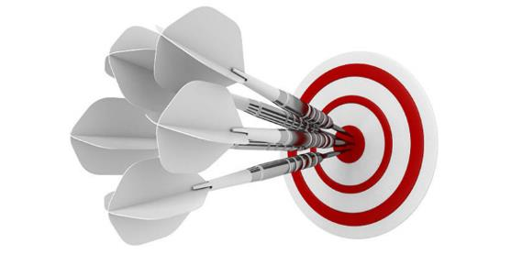
Precision Safety Reporting
sbeales@wcgclinical.com

Slide 2
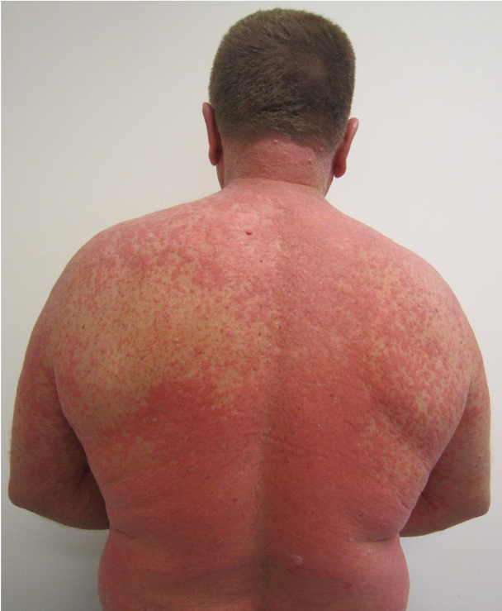
Every 30 seconds
Notes:
In the next 30 seconds, someone will be admitted to hospital suffering from a serious adverse drug reaction - 6.5% of all patient admissions, over 1m admissions per year are serious ADRs, not including 400-500k within hospital ADEs.

Slide 3

Every 10 mins
Notes:
It was a total shock to me to calculate that by the time we finish this talk, 2 people in the US will have had fatal drug reactions. 1 child will have had a life threatening drug reaction. Statistically, 1 of us in this room will end up in hospital from an adverse reaction this year.

Slide 4
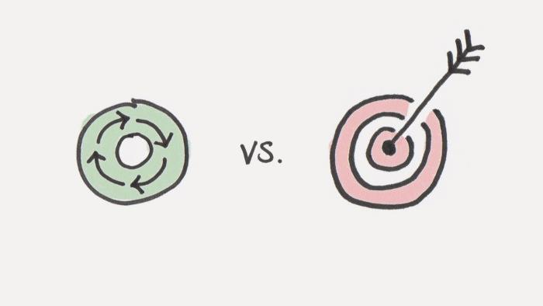
Suffers
Profits
Notes:
If we want to understand any problem in America, we need to focus on who profits from that problem, not who suffers from the problem.

Slide 5

Post-marketing
PV
Sales
Notes:
From 2003-2017, 0.3% of sales was spent on post market pharmacovigilance – for comparison purposes, less than the 0.5% share of popular vote Evan McMullin, the independent Mormon from Utah, won in the 2016 Presidential election.

Slide 6

2016
2014
2010
2003
0.8B
1.5B
2.6B
2.9B
Notes:
Meanwhile total drug development costs are out of control. Estimates from Tufts show they have more than tripled in past 15 years.

Slide 7
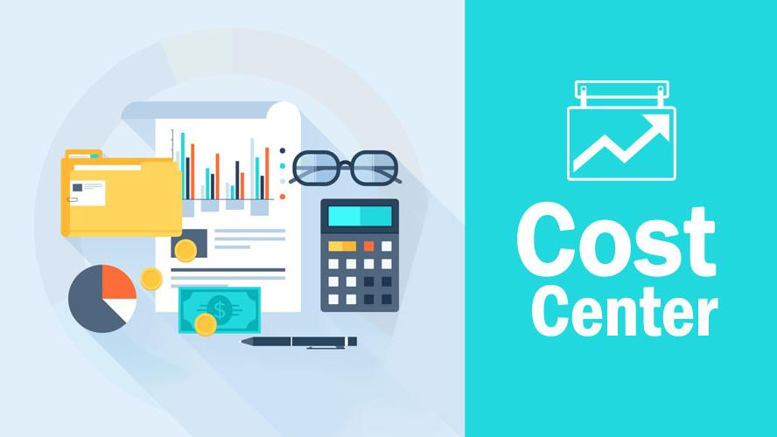
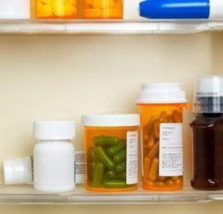
Notes:
We, as Drug Safety professionals are under ever increasing pressure to do more with less. Drug Safety is primarily viewed as a cost center.

Slide 8
900k Potential AEs
373k
AR
100k
SAR
10k SUSAR
1.2m
RA
Greatest cost
25m
Site/EC
Notes:
Here is a top 3 pharma’s drug safety funnel. Where is the greatest cost and effort expended? It’s where the least attention is paid – distributing to sites.
900k potential AEs, 373k ARs, 100k SARs, 10k SUSARS, 1.2 M RA reports, 25m Safety Letters.

Slide 9

Review Your Contracts
# 1
Notes:
Call to Action 1 - review your safety distribution costs in your contracts.
You will be stunned at the inconsistency. Sometimes costs are per site, sometimes per safety letter, sometimes flat fee.
Across different trials on same compound the costs will be different even with same provider.

Slide 10
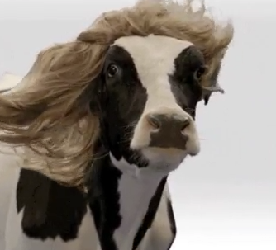
Cash Cow
Notes:
You may well uncover a cash cow in disguise.
The largest cost I’ve seen on 1 trial for Safety Reporting is $7.8m for a 4 year trial.
Clinical trials safety reporting costs are often hidden in other budget line items, so we don’t know what the real cost is.

Slide 11
Centralize Safety Reporting
# 2
Compound Level
Notes:
Call to Action 2 - Centralize safety reporting within your organization to eliminate over-spend. Safety Reporting is a compound level activity that belongs in drug safety not clinical operations because of cross reporting.

Slide 12

Inside every single one of us, we have the most powerful device known to humankind
Notes:
This is our current reality …
Inside every single one of us, we have the most powerful device known to humankind
And that's an idea.

Slide 13
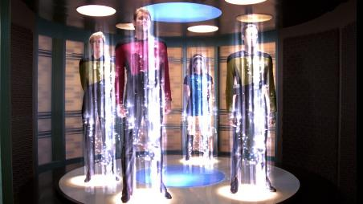
Right Information
Right Person
Right Time
Notes:
Our idea was to build a universal safety transporter. Imagine saying “Computer, “beam” my safety information to the right person at the right time anywhere in the world.
We were a couple of centuries early for star trek so we had to build the platform ourselves.
It has taken us more than 7 years.

Slide 14
2 Top 3 Sponsors
Top 3 CRO
2 Top 3 IRBs
Top 3 Biotech
Precision Safety Reporting
Notes:
An idea is powerless if it is communicated and doesn’t resonate.
2 of the top 3 Sponsors, 1 of top 3 CROs, 1 of top 3 biotech and 2 of top 3 IRBs understood the economic, safety and compliance reasons to embrace the future and implement precision safety reporting – getting the right information to the right person at the right time anywhere in the world according to local laws. Our first task was to assemble all the different country legislation so we could build a rules-based artificial intelligence. It was a more painstaking journey than we envisaged.

Slide 15
Clinical Trials are Complex
Multiple countries, global and local teams
Multiple Partners
Combination and multi-compound studies
Notes:
Why is it that safety reporting seems to be more difficult every year, despite the advances and new technologies available?
Clinical trials are complex
Very large clinical trials are magnifying some of the underlying problems we face managing global and local teams and multiple partners

Slide 16
Lack of Global Harmonization
Unclear Regulations
Marketing Status
Accountability
Notes:
Lack of Global Harmonization is No 1 problem listed by pharma executives
Regulations are unclear and rules vary from country to country.
Marketing status, Expanded Access, Investigator-initiated trials all cause rules to vary
No clear accountability for who is responsible for what

Slide 17
Lack of Precision Distribution
No Standard Process
Multiple System Integrations
No Clear Country Rules
Notes:
No standard process for sponsors to follow to distribute safety reports with the precision needed by our sites and ethics so they can focus on what they need to manage patient safety in the study
Safety report distribution is managed by study teams resulting in many interpretations of what is needed
No clear country rules. We have countries where Investigators require all SUSARs vs those that do not require any or country specific or protocol specific SUSARs

Slide 18
Lack of Transparency
No Quality Oversight
Study vs Compound
Fear of Regulatory Repercussions
Notes:
Fear of regulatory repercussions results in many companies sticking to the old Drug Safety mantra of “Send the same thing to everyone” even though legislation is constructed differently in different countries to spread burden between RAs, ECs, Sponsors and Investigators.
Quality oversight to know the sites and ethics have gotten the right information is difficult. Many sponsors cannot trace the chain of custody of their unblinded information to ECs when inspected.
Safety Reporting is often managed on a study by study basis resulting in over-distribution but clinical trials sites typically are participating in an average of 3 or more studies

Slide 19

Site Burden
Too Many Reports
Duplicate Reports
Overly Time-consuming
Too Many Websites
Useful Information Hidden
Notes:
80% of sites get more than 20 SUSARs per month
20% have refused to process a SUSAR because it was an over-distribution e.g.
A US IND Safety Report with non-sponsor causality or a SUSAR sent to an Australian investigator, who should receive line listings, not individual reports per country rules.

Slide 20

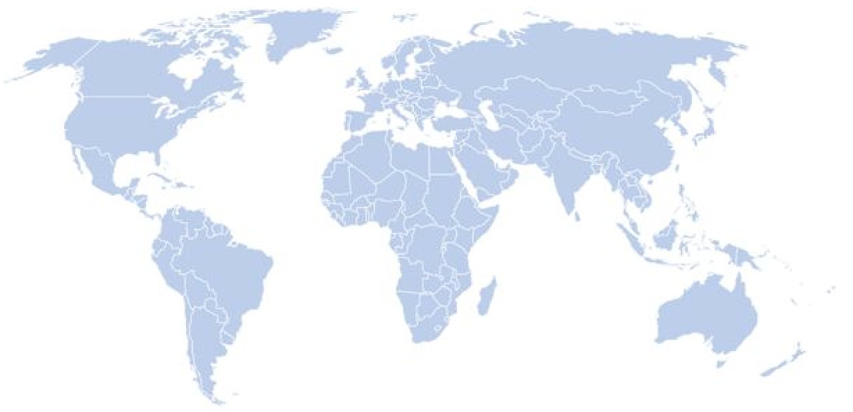

Precision Distribution
Safety Reference Model
Unburdened Resources
Quality Oversight
Notes:
What did we build in order to overcome these challenges?
A rules-based Artificial Intelligence that uses an evolving safety reference model of regulatory Intelligence from 125+ countries to power precision distribution to sites, EC and RAs in those countries.
The AI considers causality, blinding and unblinding, RSI, cross reporting, country rules, local site and EC rules when making its distribution decisions.
Inspection Readiness and traceability were at the core of the design – always distribute to local laws and alert those responsible in real time if there is a transmission failure and a risk of sites/ECs not getting timely information.

Slide 21
“System is seriously phenomenal compared to other sponsor’s pharmacovigilance systems”
Notes:
PI at Columbia University

Slide 22

Reduction in Site Burden
Notes:
Average reduction in Safety Reports = 5
2 hours per Safety Report
Measured over 30k sites

Slide 23
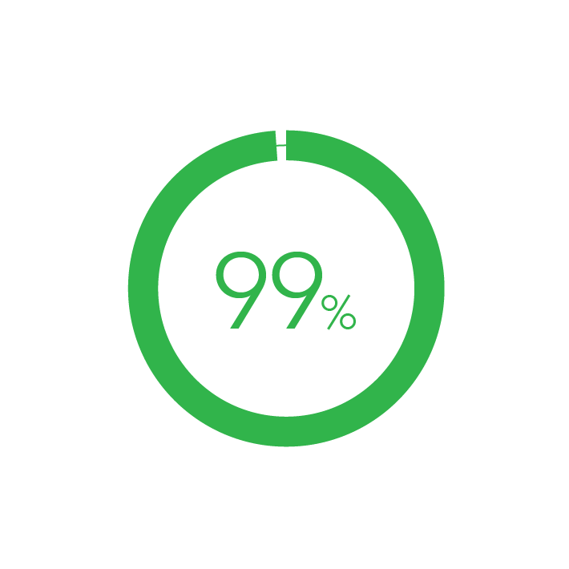
Sites in Compliance
Notes:
Trained active users accessing system and receiving delivery.

Slide 24
Costs Avoided
175 - 450k per trial
Notes:
Figures measured from over 2000 trials. 175k vs basic technology and 450k vs manual distribution.

Slide 25
Improve Patient Safety
Make Sites Happier
Pass Inspections
Avoid Costs
Notes:
By eliminating over-distribution of safety reports, you will transform your clinical operations, improve patient safety, reduce site burden, improve compliance, and save money.

Slide 26

Notes:
Change is never painful, only resistance to change is painful. Join us in building the safety reporting reference model. May all your future safety reporting be accurate and precise.

Slide 27


Slide 28
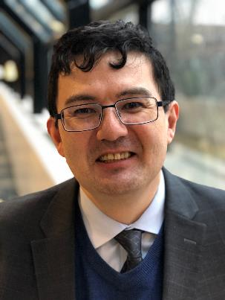
Steven Beales
SVP, Safety Solutions, WCG
sbeales@wcgclinical.com
610-834-6209

